Slide 1
Technology driven Investment management
Notes:
Hey everyone its super great to be here in not so sunny Johannesburg!!!
I’m jonjon and I’m here representing lima capital! The core of what we do at Lima Capital is Technology driven investment management – but I’ll get more into that later.
So many of you will know Jacques, he’s give a couple of awesome talks and was instrumental in putting together such an amazing event. Its really great to see someone so passionate driving this space forward and getting the machine learning community together. So thanks Jacques and everyone else who has been so instrumental in putting this day together.
So I actually met Jacques as we were both creating course content and lecturing for the WQU master course in financial engineering. Jacques was doing the ML in finance content and I was doing all the blockchain content. Side note: I love building cool things using the blockchain, and if that different side of things interests you, come say what’s up! A little passion project of a few friends and mine is raising funds for endangered animals through an innovative blockchain platform, that relies on a literally radical economics, using always for digital assets. But that’s a story for another day!
How on earth did I get into the ML in finance space and what’s my journey been? So my Brother is quite a it older than me and he’s an asset manager in the UK for investec, and he always got me to read books like the Turtle trader etc… and it got me fascinated. Blackjack, poker, trading, it all sounds so exciting right. Its not super clear how to get into the space, I mean when you go to uni there is no real specific degree for it. I ended up going the mathematics and computer science route, and then going through with CFA, I am going to write level 3 this coming June.
I’m super stoked to be up here talking and hopefully delivering some interesting nuggets of knowledge. The past 2 years I’ve been lecturing some computer science classes at the university of Cape

Slide 2
Lima Mission
Enhancing investment management through technology and cost efficiency
Notes:
So I’m going to start off by telling you a little bit about the mission of Lima capital which is going to tie in to what we are doing, and that is enhancing investment management through technology and cost efficiency. I fundamentally believe that’s what a lot of us are trying to do right now. As you are all aware of, active managers charge a large amount of fees and their investment process is of quite subjective and I would say on a hunch or a feeling, and don’t get me wrong, some of them smash it, but for the most part people are paying for a guy to select stocks that might as well be randomly selected in many cases.
So the technology part, and what we are all here for today, is creating a methodical and repeatable investment process using technology. This obviously scales well, and once built allow users to compete on cost efficiency.

Slide 3
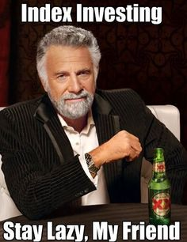
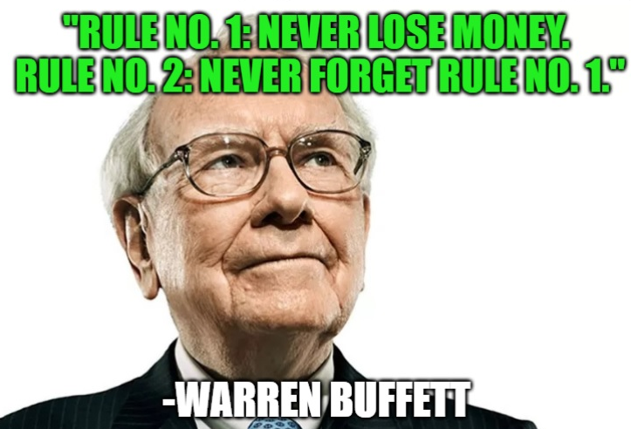
Constructing Investment strategies using ML
Notes:
So I’ve titled my talk, constructing investment strategies using Machine Learning. It’s a bit of a catch all and vague title, but hey I’m hoping to come in real and raw and hoping everyone hear can take something away from this today.
Promise I’m not going to talk on the ethics of AI hahaha cause I know that’s exactly not what we are here for .

Slide 4
Some questions to unpack (from De Prado’s book chapter 1)
“According to Institutional Investor, only 17% of hedge fund assets are managed by quantitative firms. That is about $500 billion allocated in total across all quantitative funds as of June 2017, compared to $386 billion a year earlier. What do you think is driving this massive reallocation of assets?”
“What is the key difference between econometric methods and ML?”
“Science has a very minimal understanding of how the human brain (or any brain) works. In this sense, the brain is an absolute black box. What do you think causes critics of financial ML to disregard it as a black box, while embracing discretionary investing?”

Slide 5
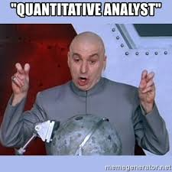
What is the key difference between econometric methods and ML?
Old quant vs new quant?
Notes:
Using ML in finance is like teenage sex – excuse the crude explanation but Jacques actually came up with this one. Everyones talking about, everyone says they are doing it, but actually no one is really doing it.
So lets unpack this question a little more as I feel its pretty vital to start here. Since we are obviously at a Machine Learning in Finance meetup, not an econometrics in finance group.
Okay so want to talk about a problem, and how say a classic old quant, or econometric model might solve it, then contrast the machine learning approach, this will be useful I think. This is actually based on the example that Marcos Lopez de Prado gave a couple weeks ago when I was in London, Jacques was also there I believe.
Okay so you have this problem where a credit card company, lets say Monzo, anyone familiar with big online digital banks???? Right they are this crazy and upcoming digital bank, in fact Jacques Wife works there, they are awesome. They wanting to provide an awesome customer experience, are interested in predicting credit card fraud. Right, you’ll notice that
So they come up with these rules like, when a transaction happens in two different countries within 2 hours block the second one, because logically how could someone travel so quickly right? Maybe this is something they observe in past transactions so this is definite rule that is programed in by them.
Practitioners try and infer the relationships and come up with rule based scenarios and alogrithms that execute based on that.

Slide 6
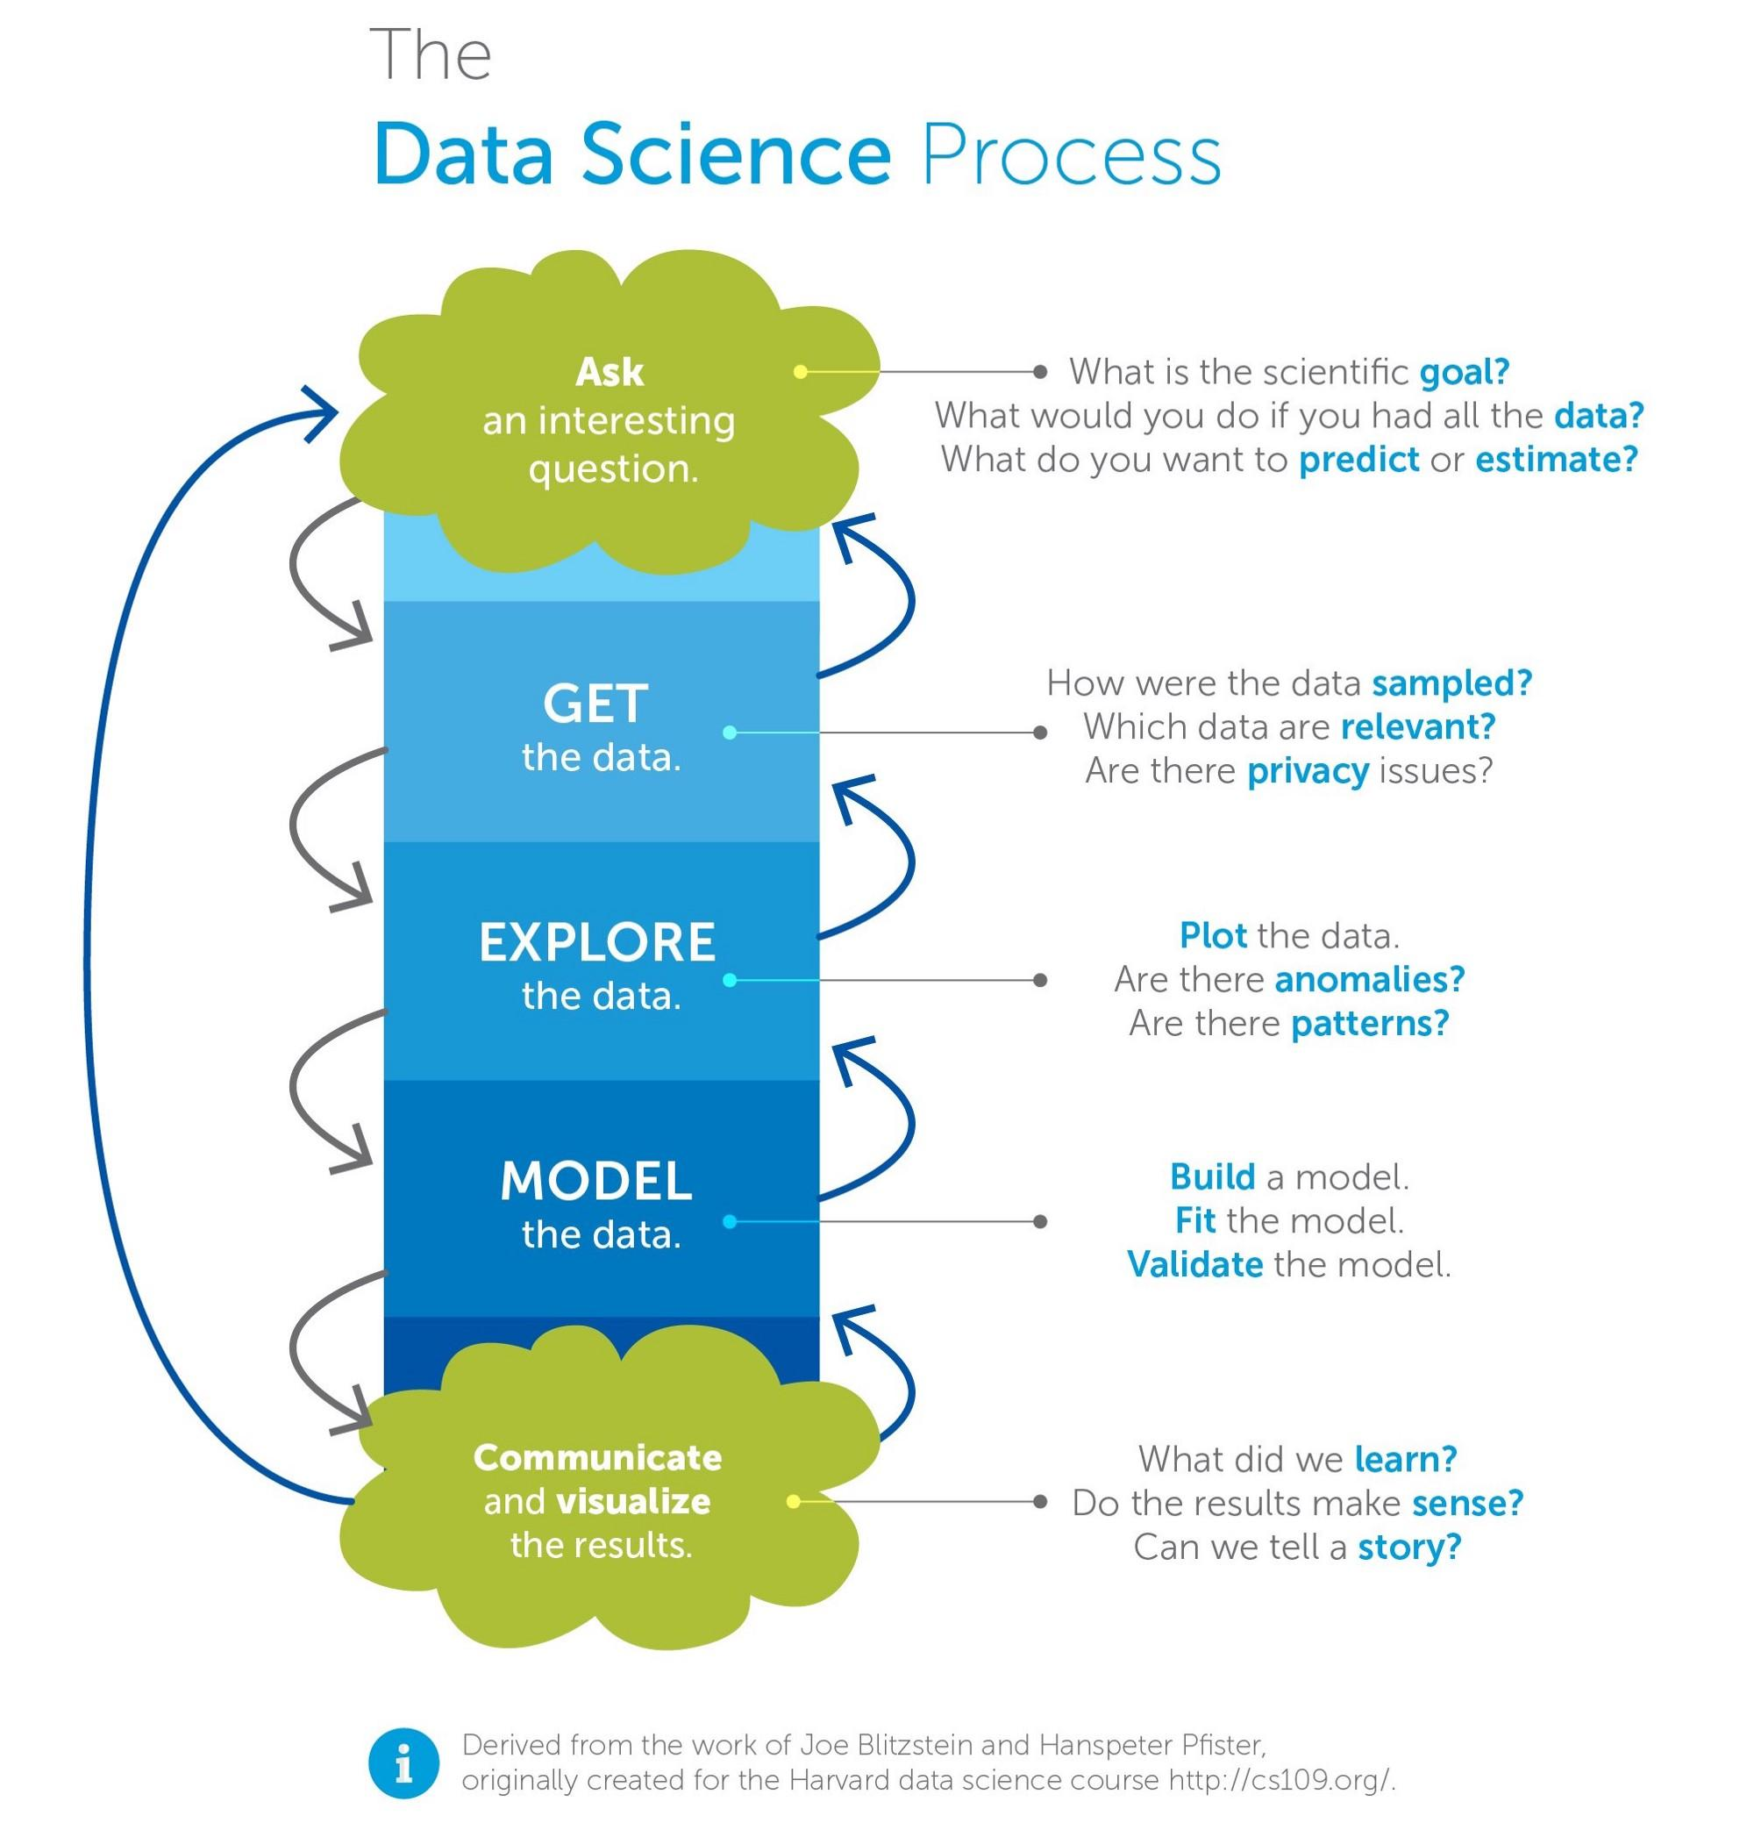
Background
Data science & machine learning?
Machine learning is one core component in the an investment framework.
Machine learning
Notes:
Explain how credit card fraud would work now in terms of supervised learning.
Parameters, like amount, time, location, currency, time since last transaction.

Slide 7
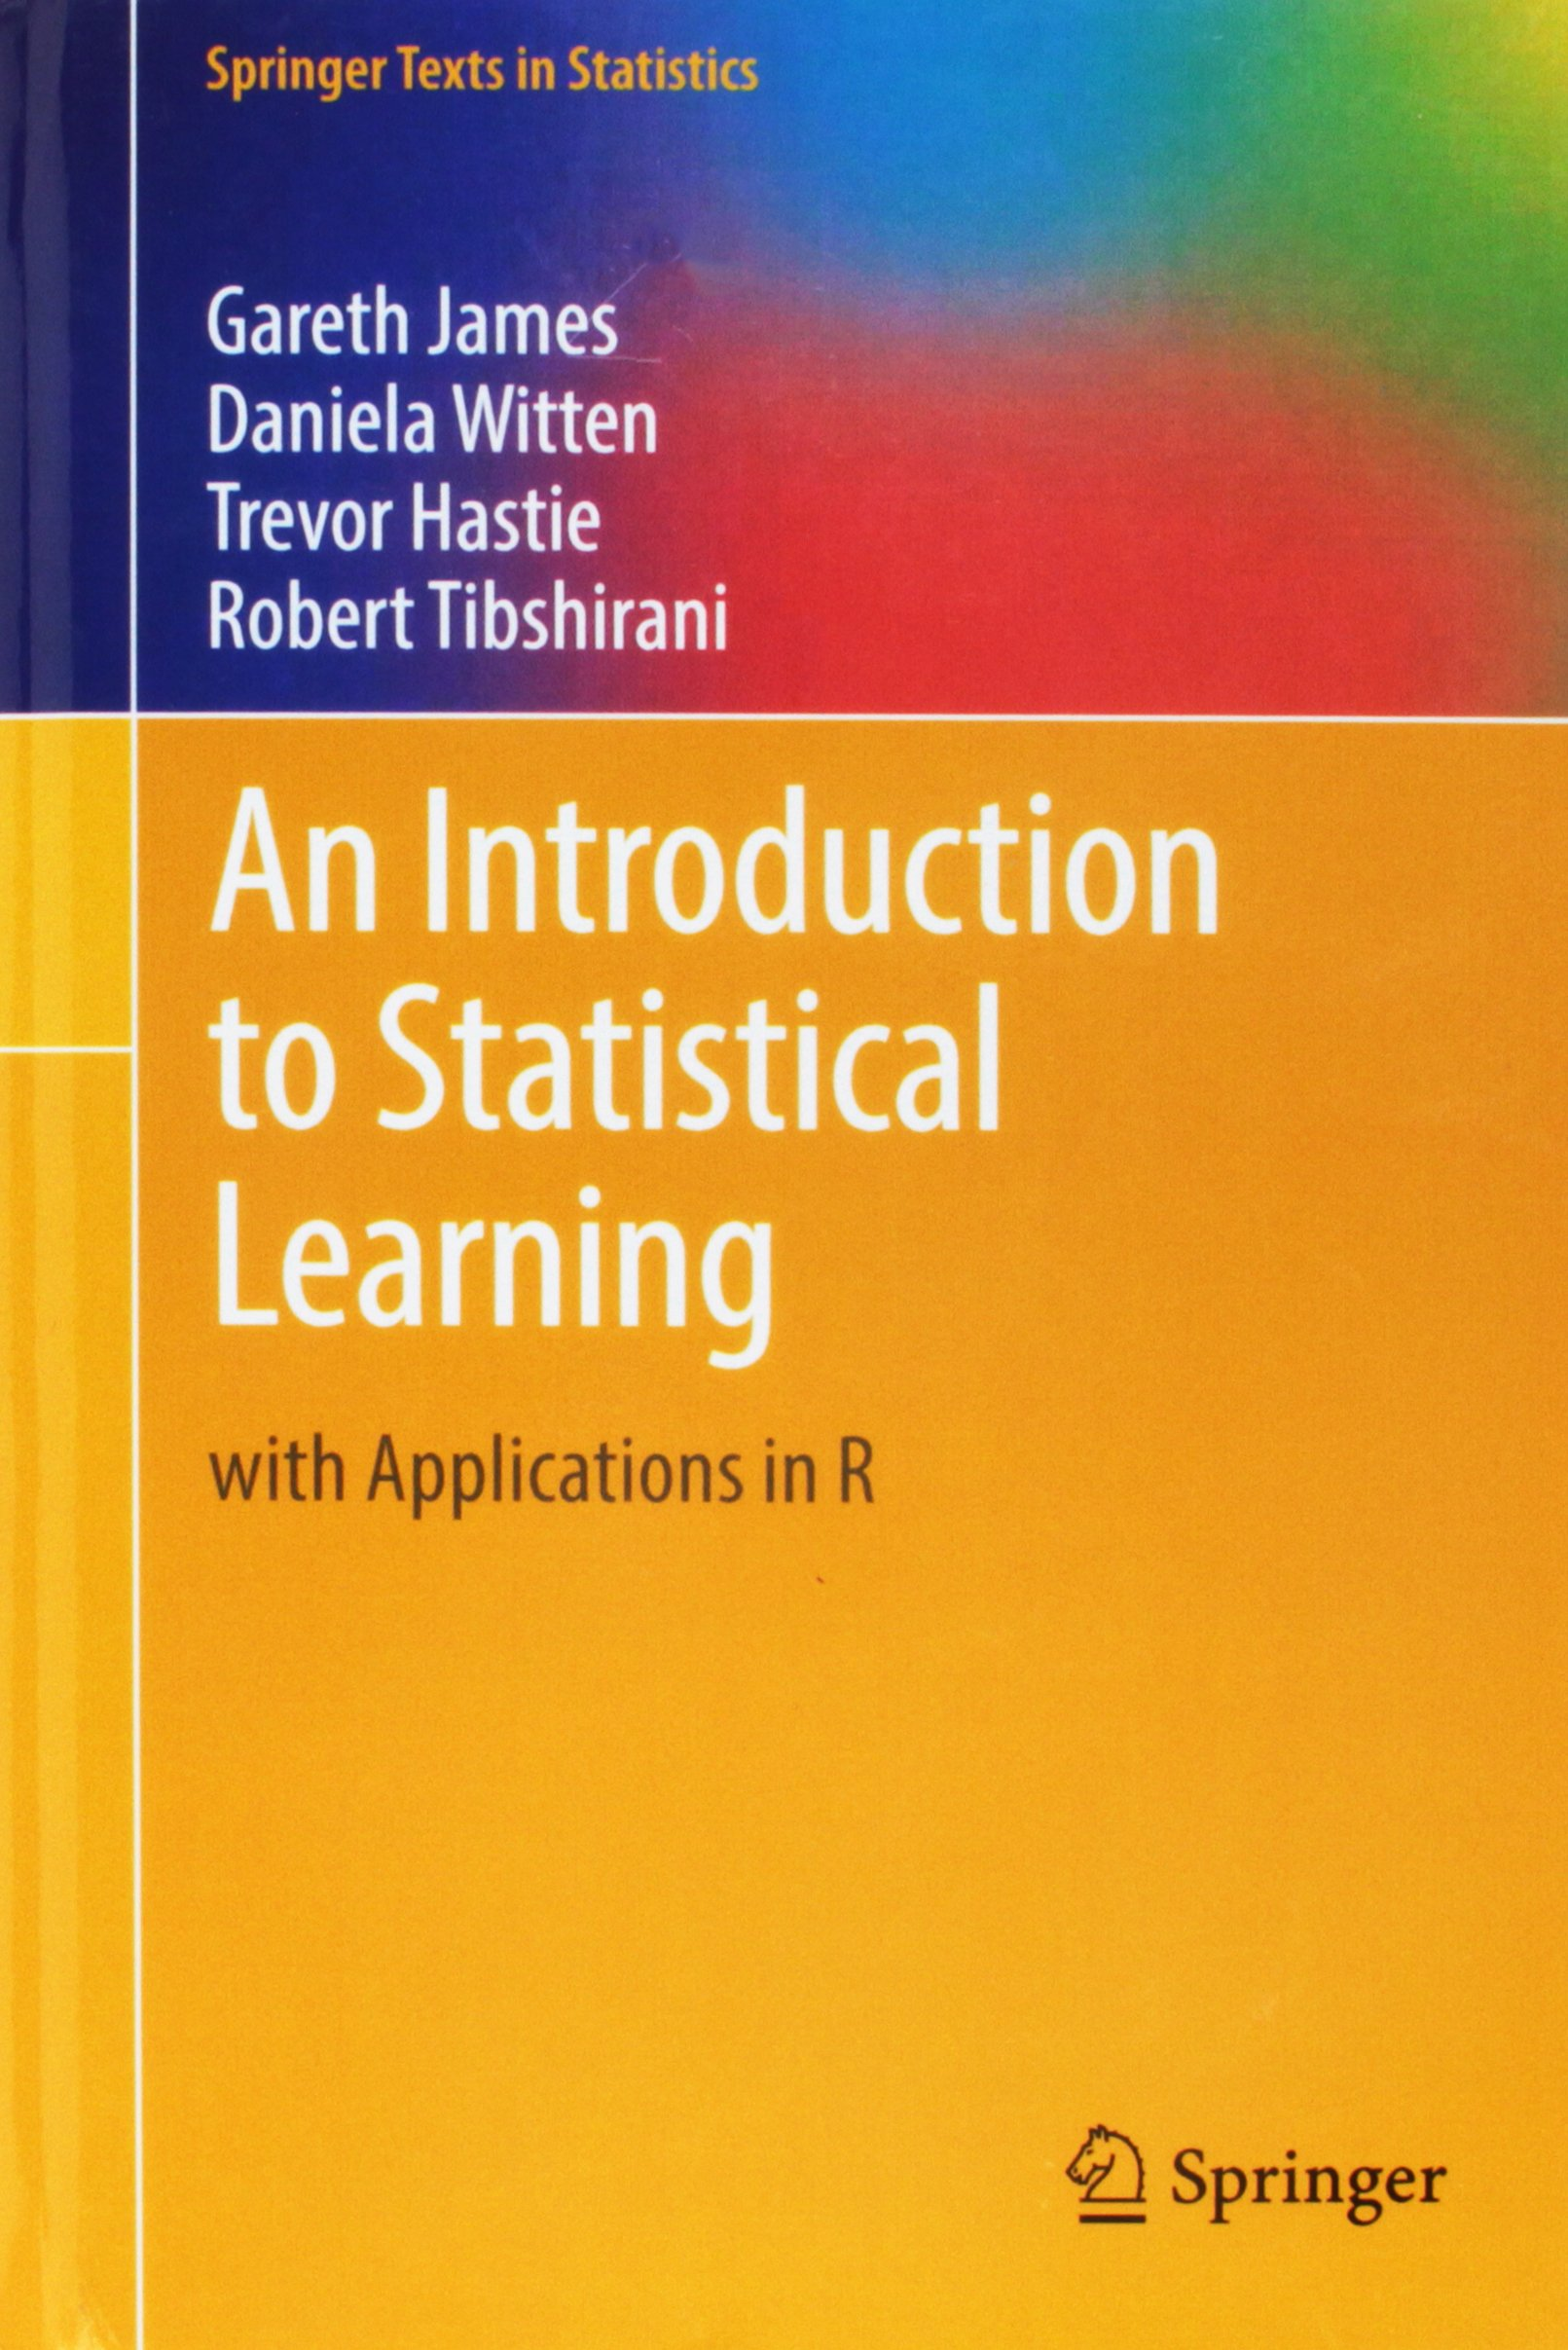
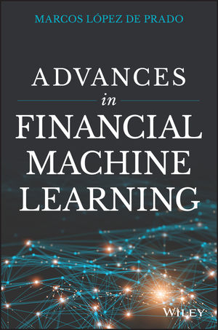
Can’t recommend enough

Slide 8
Why is data science difficult in the finance context?
-Non stationary data
-Low signal to noise ratio.
-History (past market data) is essentially just one occurrence of a stochastic process
Notes:
Time series not stationary.
Limited data
Low signal to noise ratio. I.e. there is a lot of randomness in the data set they you essentially don’t want your model to learn right. Otherwise this would lead to poor predictions in the future. What are we more interested in? We are more interested in the ‘signal’ and learning meaningfulness.

Slide 9
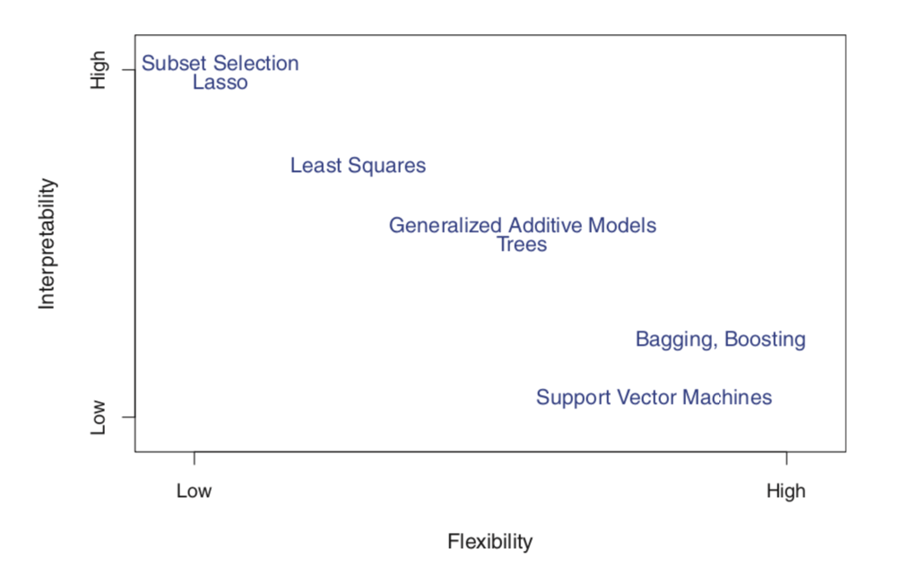
What do you think causes critics of financial ML to disregard it as a black box?
Notes:
Trade off between interpretability and flexibility

Slide 10
Lima capital core beliefs
Equity beta is best.
Stock level diversification has value.
Asset class diversification has limitations.
Risk management is key and draw down minimisation matters.
Trade execution can be the difference between success and failure.
Behavioural finance and human biases destroy value.
Narrow application of machine learning leads to consistency and repeatability.
Clear solution outcome objectives necessary.
The overarching key success factor in investment management is a consistent, repeatable investment process driven by adaptive machine learning algorithms, with human oversight but NO human intervention.
Time is the only silver bullet in investment management.

Slide 11
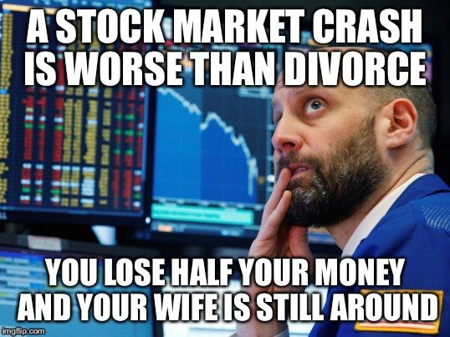
Downside protection
Lima’s solution
A mutual fund buying beta in the form of an exchange traded fund (ETF) and dynamically prescribing insurance (exiting out of the market) to that position when needed, utilizing an autonomous investment process as described above with human oversight but no human intervention.

Slide 12
Building a robust pipeline to test
-Be clear on objective measurements to determine success (Feature importance, F1 score etc…)
-Try use a manifest --
Example: a document listing a ship's contents, cargo, passengers, and crew, for the use of customs officers.
a list of passengers or cargo in an aircraft.
a list of the wagons forming a freight train.
Helps you to define and understand all the components being utilized in you data science pipeline. Modular design will allow various experiments, easily replacing certain pieces.

Slide 13
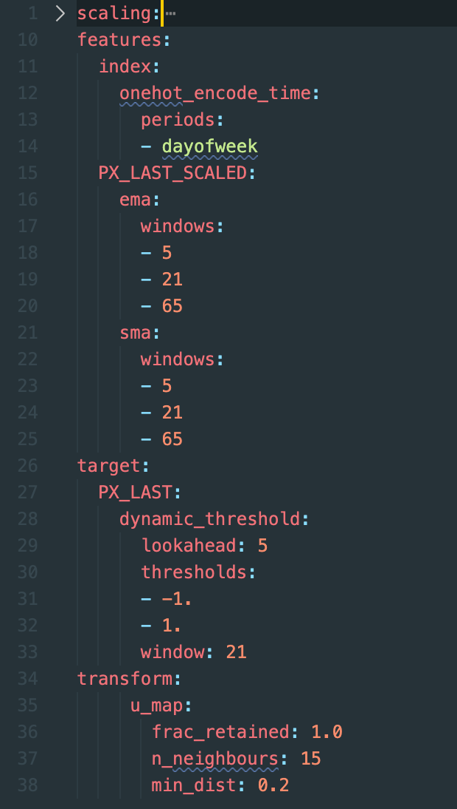
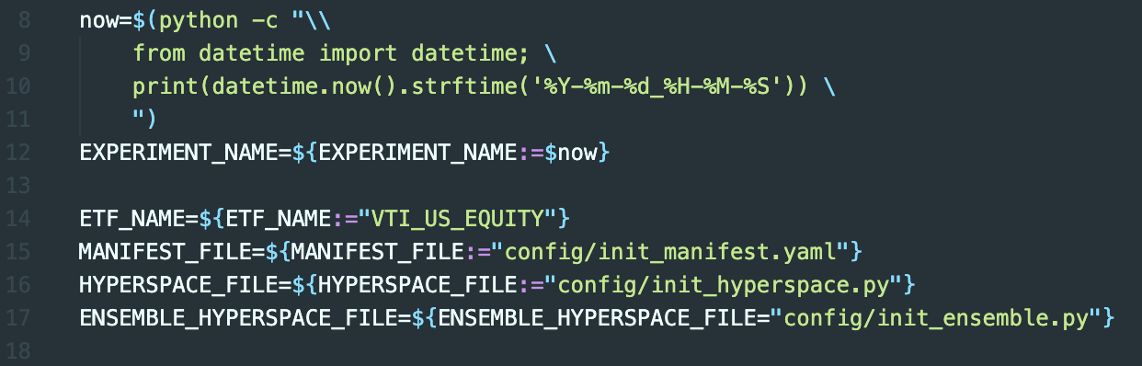
Basic manifest example
-This is a .yaml file
-Then you can have shell scripts that simply invoke these manifests

Slide 14
Downside protection
Lima’s solution
A mutual fund buying beta in the form of an exchange traded fund (ETF) and dynamically prescribing insurance (exiting out of the market) to that position when needed, utilizing an autonomous investment process as described above with human oversight but no human intervention.

Slide 15
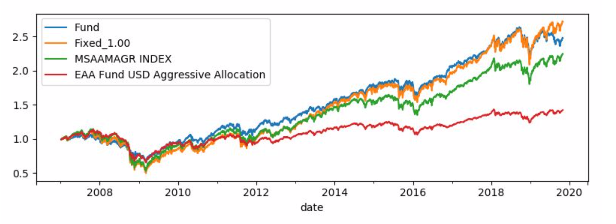
What it may look like in practice?

Slide 16
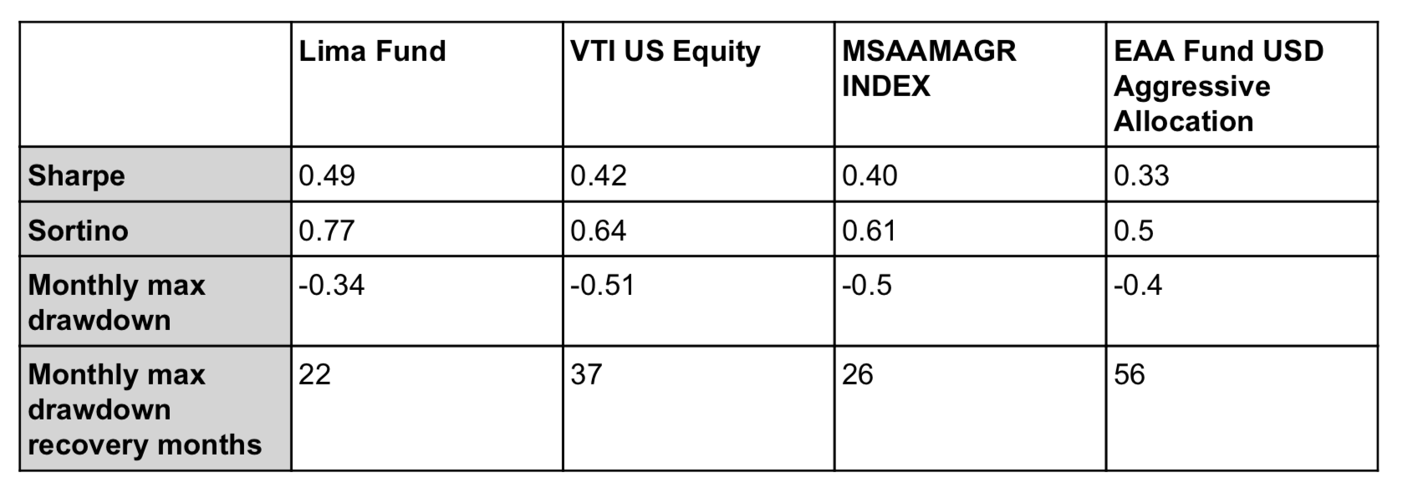
What it may look like in practice?

Slide 17
Some thoughts?
Is this approach better than more traditional investment strategies and or a multi asset fund?
No, not necessarily. It uses an alternative investment process driven by technology, to achieve a similar result, whilst focussing heavily on cost efficiency. The implementation of the strategy is driven by the philosophy that drawdown risk can be managed with techniques other than asset class diversification.

Slide 18

Visit
https://lima.capital
for more info

Slide 19
Regulatory Notice
This document was designed to provide a brief description of the features of Lima Capital LLC and the investment choices available. It does not constitute an offer or solicitation to anyone. It is presented for information purposes only. Investments with Lima are subject to market risks. Investments can go down as well as up as a result of changes in the value of the investments. There is no assurance or guarantee of capital or performance. Investors may lose money including possible loss of capital. Past performance is not necessarily a guide to future performance. Lima does not make any representations that products or services described or referenced herein are suitable or appropriate for an investor. Many of the products and services described or referenced herein involve significant risks, and an investor should not make any decision or enter into any transaction unless the investor has fully understood all such risks. Any discussion of risks contained herein with respect to any product or service should not be considered to be a disclosure of all risks or a complete discussion of the risks involved. Investors must make their own independent decisions regarding the suitability and risks of any strategies or financial instruments mentioned herein.

